Slide 1
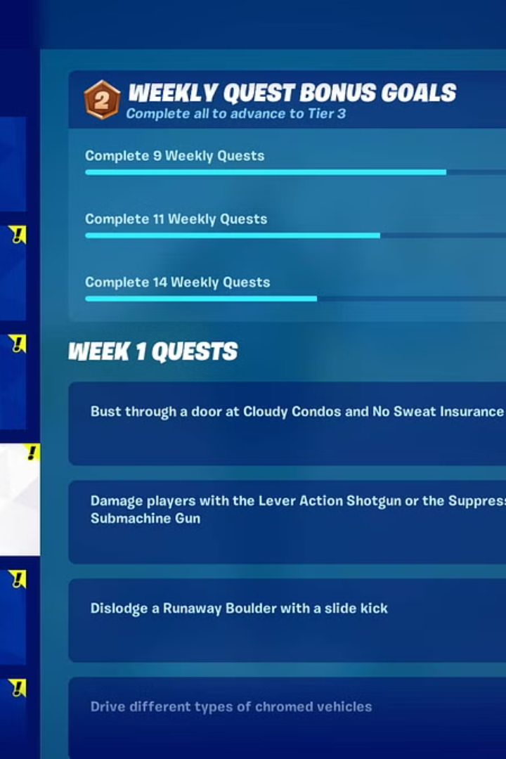
QuestMaster: Gamifying Productivity
Unlock your true potential with QuestMaster, a revolutionary productivity app that transforms your daily tasks into engaging quests. Embark on a journey of self-improvement and watch your efficiency skyrocket.
By Ravi Agrahari

Slide 2
Enhancing Productivity through Gamification
Motivation Boost
Focused Attention
Sense of Accomplishment
QuestMaster taps into the innate human desire for achievement, progression, and reward, keeping you motivated to tackle even the most daunting tasks.
By framing your to-do's as quests, QuestMaster helps you stay laser-focused, minimizing distractions and enhancing your overall productivity.
Completing quests and unlocking new levels provide a tangible sense of progress, fueling a positive feedback loop that drives you to achieve more.

Slide 3
Key Features of QuestMaster
Task Management
Quest Board
Progress Tracking
Easily organize and prioritize your tasks, breaking them down into manageable quests with clear objectives and deadlines.
Visualize your progress on a dynamic quest board, where you can track your achievements and unlock new challenges.
Monitor your productivity metrics, including time spent on tasks, completion rates, and personal bests, to continually improve your efficiency.

Slide 4
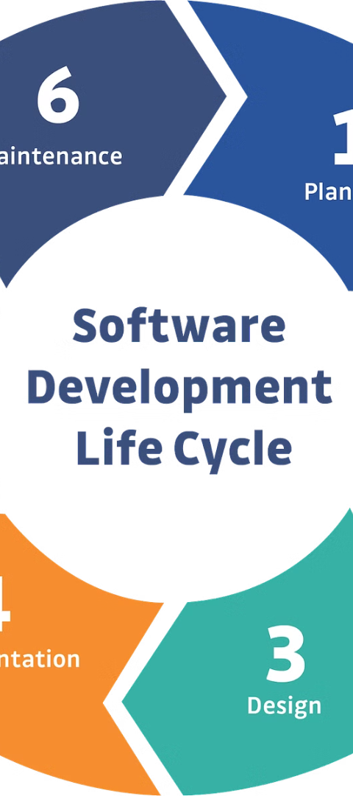
QuestMaster's Implementation Plan
1
Phase 1: Prototyping
Develop a functional prototype to test key features and gather user feedback, iterating on the design and user experience.
2
Phase 2: Development
Implement the core functionality of QuestMaster, leveraging modern technologies and frameworks to ensure a seamless, responsive, and scalable application.
3
Phase 3: Beta Testing
Release a beta version to a select group of users, collecting insights and making necessary adjustments before the full launch.

Slide 5



Future Enhancements and Conclusion
Integrations
Advanced Analytics
Community Features
Seamlessly integrate QuestMaster with popular productivity tools and platforms, enhancing the user experience and fostering a more comprehensive approach to task management.
Leverage machine learning and data-driven insights to provide users with personalized recommendations and optimization strategies, further boosting their productivity.
Introduce collaborative elements, such as leaderboards and group challenges, to foster a sense of community and healthy competition among users.
QuestMaster is the ultimate productivity companion, transforming your daily tasks into a thrilling adventure

